Slide 1
Anycast Networks
Shane (Xiao) Zhang
Bruce Maggs

Slide 2
Outline
What is an Anycast Network
Anycast Applications
Geohint-based Performance Optimization (SIGCOMM 2018)
How to predict Anycast (AnyOpt SIGCOMM 2021)

Slide 3
Internet Routing Schema
Unicast
Broadcast
Multicast
Geocast
Anycast

Slide 4
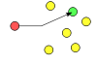
Unicast
The most common routing schema
Two endpoint entities in the communication
Example:
ssh to a server
Request a web page

Slide 5
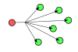
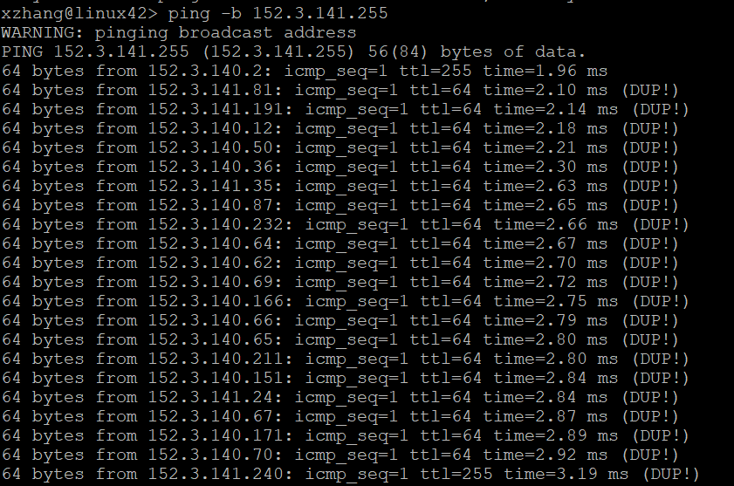
Broadcast
Usually happens within a network
To capture group reply
Example
Broadcast ping with –b
DHCP

Slide 6
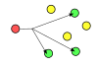
Multicast
Send message to a specific group of hosts
The intermediate hosts will replicate the packet to multiple destinations
Example
IPTV
OSPF

Slide 7
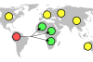
Geocast
Send notification to the user in a specific district
Amber Alert

Slide 8
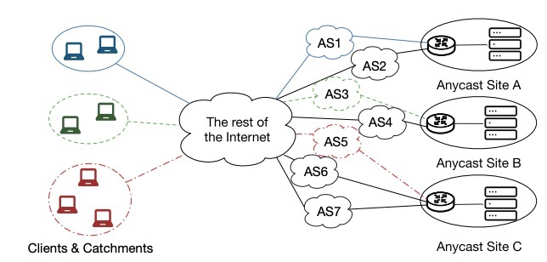
Anycast
All Sites have the identical IP*
The client’s request is routed to one of a group of hosts
Only two entities are involved in the communication
Route selected by BGP tie breaking

Slide 9
Several terminologies
Sites (Replicas)
Catchment

Slide 10
Sites (Replicas)
The servers that provide identical services from different locations
Just one single server
A cluster with a load-balancer
Can be one server or a group of servers
DNS
CDN

Slide 11
Catchment
The scope of each site’s coverage
Each client’s choice of replica is determined by BGP selection
Usually, an entire (stub) AS belongs to the same site’s catchment
during a short period of time
Routing information update will change the catchment

Slide 12
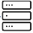
How to build an Anycast System
Anycast Site A
Anycast Site B
Anycast Site C
Own a valid IP prefix (AS)
Select several Internet Provider
Transit Provider
Private Peer
Public Peer
Announce the identical prefix from multiple routers at different locations
Announce
23.1.0.0/24
Announce
23.1.0.0/24
Announce
23.1.0.0/24
A’s catchment
C’s catchment
B’s catchment

Slide 13
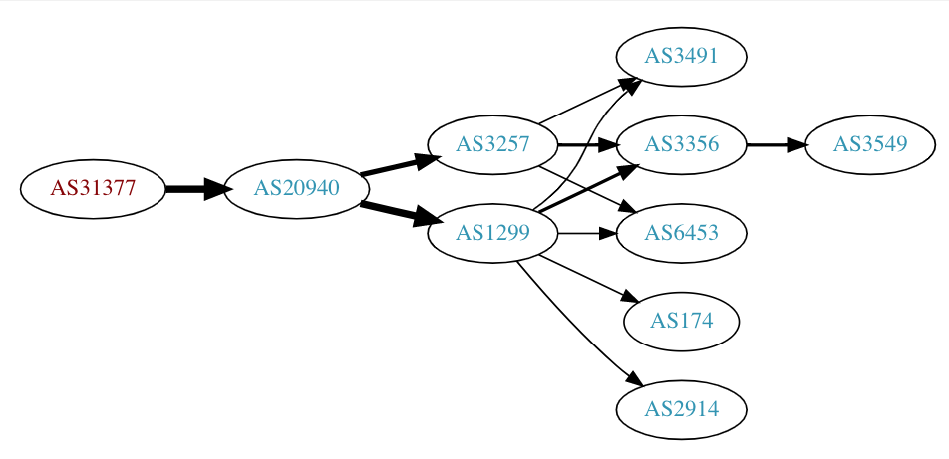
Anycast Configuration and Route Propagation

Slide 14
Related Research
Passive Service Log Analysis
Get the logs from the replicas of the anycast service
The log usually contains the IPs of clients
And the log received on different replicas indicate the catchment
Proactive Probing
Usually adopt distributed measurement infrastructure (e.g. PlanetLab, RIPE)
Send out probing (ping, traceroute) request to the anycast replicas
Use DNS Chaos request to distinguish different anycast replicas
Anycast Network Performance Optimization
MPLS based request routing
Geohints-based Tie Breaking
SFLPO total order based optimization

Slide 15
Anycast Applications

Slide 16
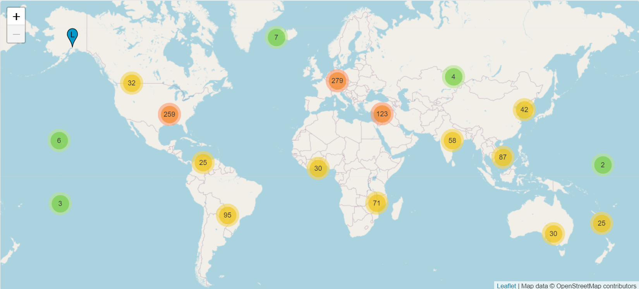
Root nameserver’s replicas
https://root-servers.org/

Slide 17
Different Scale of Anycast Systems
 |  | Property
 |  | Total Sites | Sites per Deployment | Prefix to Site Assignments | Connectivity per Site | RTTs per Content Fetch
Deployment | Microsoft CDN | 110 | 30-110 (regulatory restrictions) | By application | Multiple Transit, 100s of Peers | At least 10
 | Akamai DNS | Hundreds | 25 (spread load) | For performance | 1 Transit, Some Peers | Probably Less than One
 | Root DNS | 1400 | 6-250 (different orgs, same service) | By root letter | Various | Hardly Any
Anycast In context: a tale of two systems [SIGCOMM 2021]

Slide 18
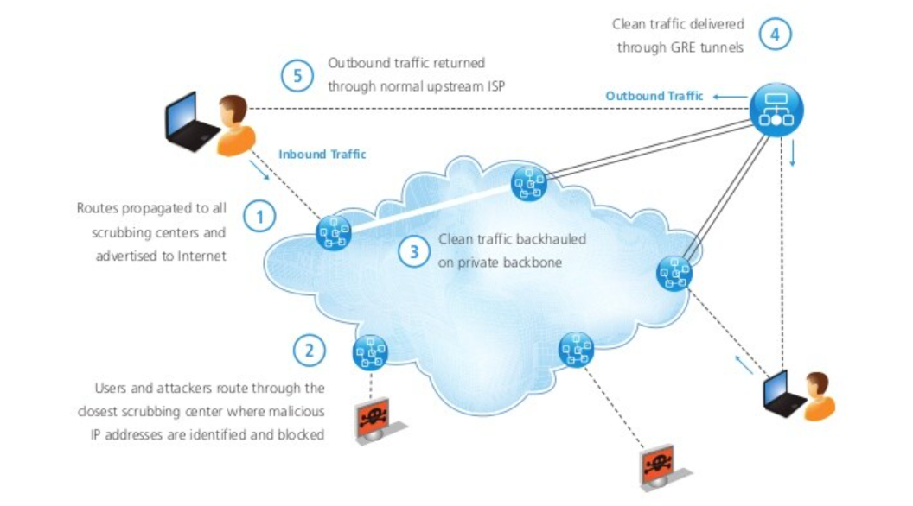
Prolexic-Anycast DDoS Mitigation System

Slide 19
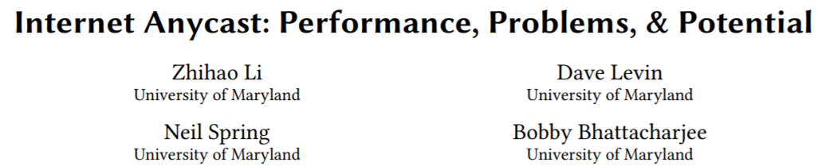
SIGCOMM 2018

Slide 20
Anycast often deploys several replicas at different geolocations
Each site announces the same anycast prefix to its transit(peering) router
The scale of anycast’s sites can be very different (6 - 254)

Slide 21
Potential Advantages
Anycast intends to direct clients’ traffic to a nearby replica
More replicas will result in better performance
Get rid of additional recursive domain queries required by DNS-based CDN

Slide 22
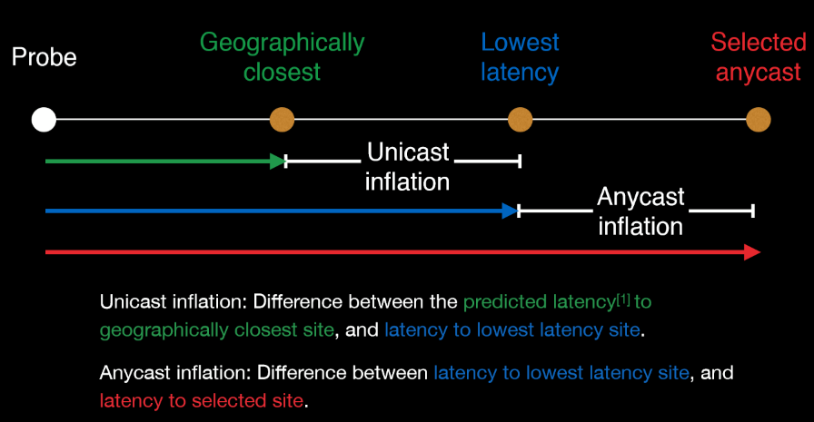
Problem?
Unable to select shortest path
Routing Policy*
Unable to distinguish shorter one while providing several other candidates

Slide 23
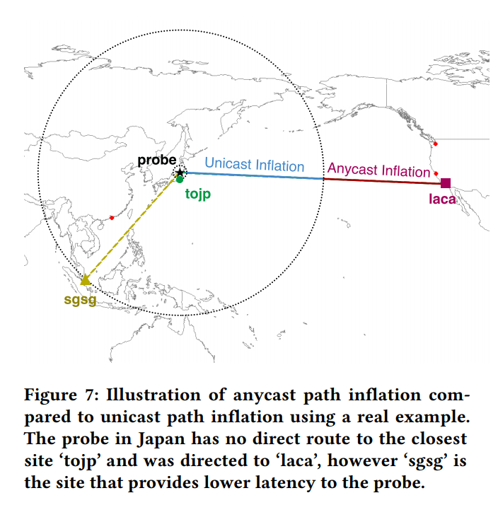
Unicast inflation v.s. anycast inflation

Slide 24
Reality
Anycast usually causes prolonged routing inflation (even compared with unicast routing inflation)
More anycast sites do not necessarily improve overall performance

Slide 25
Data source
D-root server service logs
Contain the IP of clients
RIPE Measurement Trace
Use DNS CHAOS query to determine the catchment
CHAOS query can retrieve a unique ID text (corresponding to the replica) from each anycast address
9000 probes, 180 countries and 3587 ASes
Measure 9 out of 13 DNS root servers

Slide 26
Chaos Query
dig @199.7.91.13 CH TXT hostname.bind. chaos
;; Warning, extra class option
; <<>> DiG 9.11.3-1ubuntu1.9-Ubuntu <<>> @199.7.91.13 CH TXT hostname.bind. chaos
; (1 server found)
;; global options: +cmd
;; Got answer:
;; ->>HEADER<<- opcode: QUERY, status: NOERROR, id: 14509
;; flags: qr rd; QUERY: 1, ANSWER: 1, AUTHORITY: 0, ADDITIONAL: 1
;; WARNING: recursion requested but not available
;; OPT PSEUDOSECTION:
; EDNS: version: 0, flags:; udp: 1450
;; QUESTION SECTION:
;hostname.bind. CH TXT
;; ANSWER SECTION:
hostname.bind. 0 CH TXT "abva1.droot.maxgigapop.net"
;; Query time: 12 msec
;; SERVER: 199.7.91.13#53(199.7.91.13)
;; WHEN: Fri Oct 18 14:39:05 EDT 2019
;; MSG SIZE rcvd: 81
Notes:
Chaos query can distinguish different anycast replicas

Slide 27
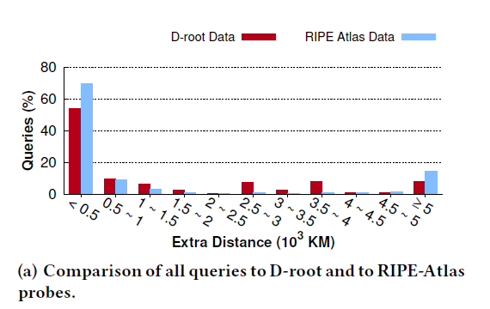
Result
Use geographical distance to evaluate the performance
Over 1/3 D-root queries travels 1000 km further (Beijing to Shanghai 1,300km)

Slide 28
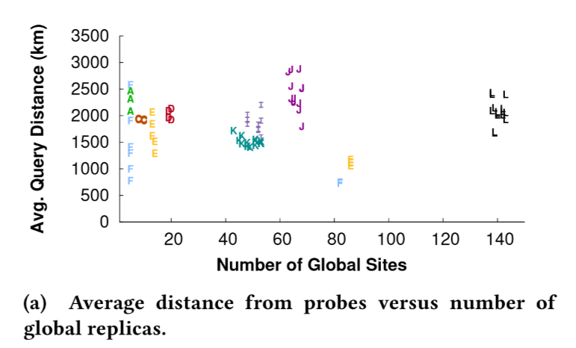
More replicas do not guarantee the improvement of performance

Slide 29
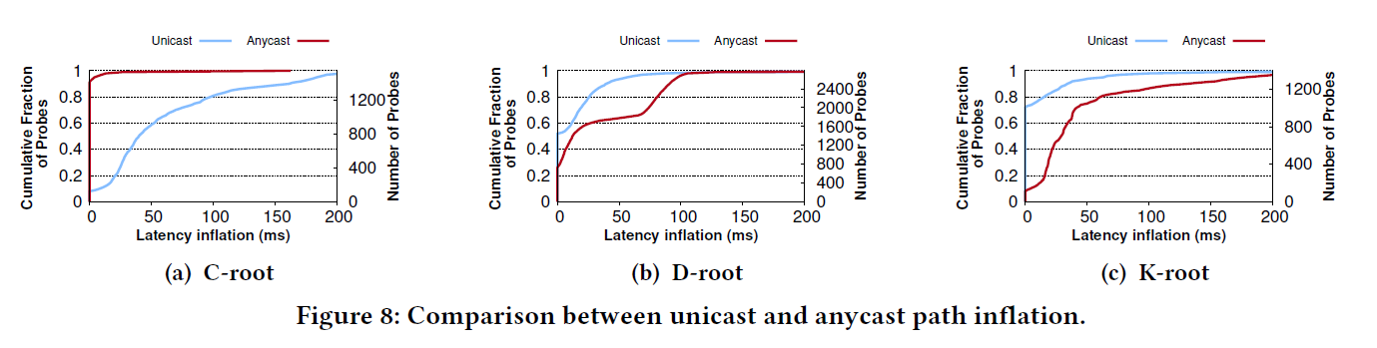
Measurement relative Path Inflation
Each anycast replica also has a unicast IP
Use RIPE to trace the unicast IP

Slide 30
Proposed Solution: Add Geographical Hints to BGP
Use Community Number (Key:Value like)
16bit:16bit
First 16bit usually is the AS number
Last 16bit 7bit(Latitude) + 9bit(Longitude)
Each Router Chooses the Nearest path based on:
BGP’s geographical hits and
Router’s geographical location

Slide 31
Conclusion
Using passive and active measurements, we have presented an in-depth root cause analysis of the inefficiencies of root DNS servers’ IP anycast deployments.
Conventional anycast deployment suffer from prolonged path inflation
Encode geographical hits in the community number can greatly reduce the path inflation by breaking the tie intelligently

Slide 32
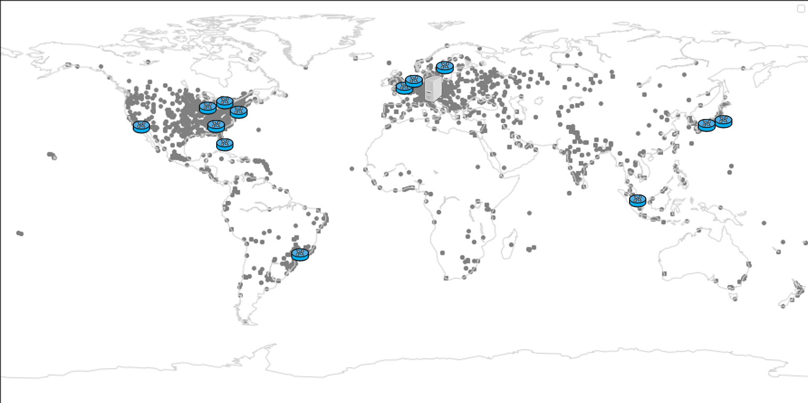
AnyOpt
Implement a light-weight anycast performance measurement system
Create Virtual Replica with GRE tunnels
Measure the anycast network from a centralized host

Slide 33
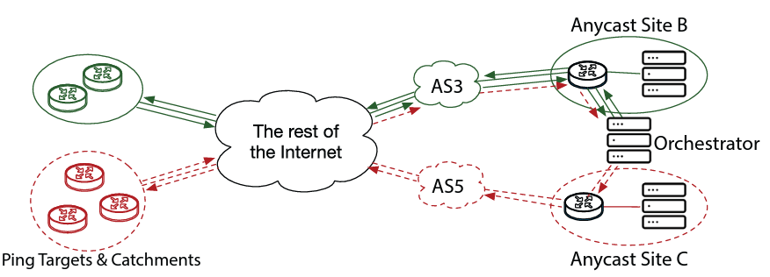
Hecatoncheires (Orchestrator)-Anycast Measurement
Build tunnels between ECP and multiple edges routers
Routers will act as different Replicas of the anycast network
Advertise the Anycast Prefix from ECP and add community number to enable the router port the prefix to different transit provider

Slide 34
Measurement methodology
ICMP Ping packet
Encode double float unix timestamp into the ICMP request content
Can extract the Round-Trip Time in a stateless manner
Use Seq to indicate the outgress router (port/tunnel)
ICMP Ping with Descending TTL
Augment the ping data with trace
Get the backward trace of the anycast network
Observe flippings at different hosts
ICMP with Route Record Header
Get forward trace to pinpoint the ramification point

Slide 35
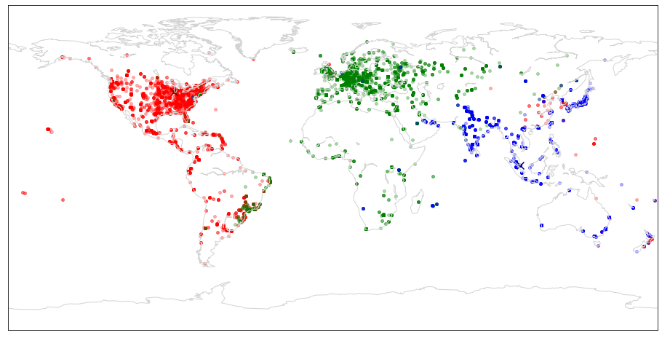





Ideal anycast behavior
Ideal avg RTT 62 ms
Anycast Site
Client
A three-site deployment: Chicago, London, and Singapore
Notes:
Ideally, we expect that clients will reach the closest anycast site so as to minimize the latency between a client and a service. For example, in this picture, we deploy a service at three anycast sites. One in Chicago, one in London and one in Singapore. (show animation of three anycast sites only).
Ideally, this is what we want the catchment to look like, each client reaches its closest site, as shown by the different colored dots.
CL
If the catchment follows this ideal distribution, the average client round trip time to their catchment sites will be only 62ms.

Slide 36
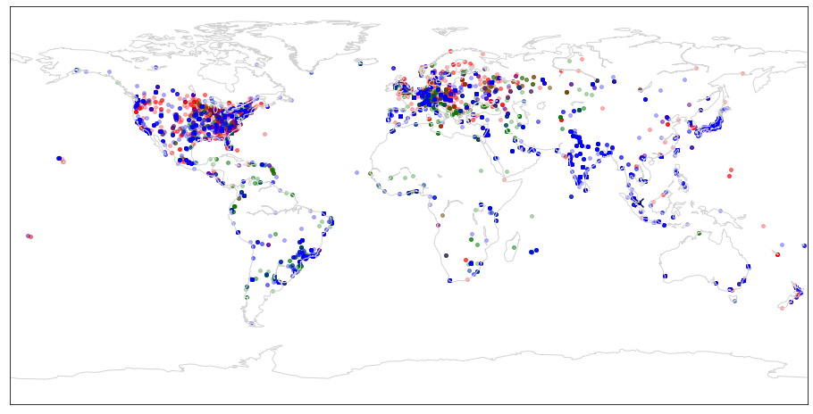
IP anycast does not minimize latency
Ideal avg RTT 62 ms
Actual avg RTT 133 ms
Clients reach far-away sites
Notes:
However, this pictures shows what the actual catchments look like. Clients do not necessarily reach their closest sites. Many clients in America and Europe reach the site in Singapore.
CL
the average client round trip time to an anycast site reaches 133ms in this case, which is more than twice as the ideal case.

Slide 37
Challenge
A service provider needs to choose anycast sites
BGP determines a site’s catchment
BGP is performance agnostic
Increasing # of sites does not always reduce latency
E.g., Li et al. [SIGCOMM 2018], Kyle et al. [SIGCOMM 2020]
Q: How to choose a subset from potential anycast sites to minimize latency?
Estimating latency requires predicting catchment
Notes:
To deploy an anycast-based service, a service provider needs to choose anycast sites to announce the anycast prefix.
A key challenge here is that mappings between client networks
and anycast sites are determined by
BGP’s policy-based routing decisions rather than service providers’
goals such as minimizing latency and balancing load. In fact, several
measurement studies have revealed that some anycast catchments
exhibit unexpectedly inflated latency, and increasing the number
of anycast sites in a deployment counter-intuitively increases the average
latency for clients.
CL
The question we aim to answer in this work is given a set of potential anycast sites How to choose a subset among them to minimize the average client latency
CL
In order to do that, we must first be able to predict the catchment and estimate the latency

Slide 38
A Strawman Approach
Experiment with all possible subsets of available sites
Measure each site’s catchment and average client latency
Choose the subset with minimum average latency
# of experiments is exponential in # of sites
Notes:
In order to minimize the average client latency, we can do this by a strawman approach.
CL
In the strawman approach, we will announce all configurations that cover all possible combinations with the available sites.
CL
Then for each announced configuration, we will measure its catchment and average client latency
CL
In the end, we will choose the configuration with the minimal client latency
CL
However, the problem of the strawman approach is that # of experiments is exponential in # of anycast sites

Slide 39

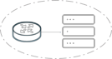
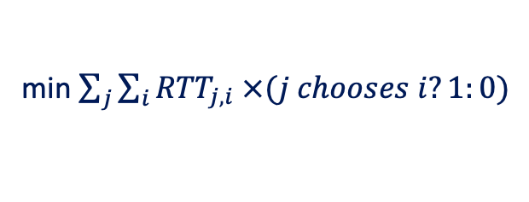
AnyOpt’s Approach
min $\sum_{j}{\sum_{i}{{RTT}_{j,i} ×(j chooses i?1:0)}}$
Measure → Model → Optimize
Measure a client’s preferences between each pair of anycast sites
Model a client’s route selection behavior as a linear preference order
Solve an optimization problem offline to minimize latency
Notes:
In our work, we took a three stage approach: measure, model, and optimize to solve this problem without conducting exponential # of experiments.
CL
First, we Measure a client’s preferences between each pair of anycast sites
CL
Then, we Model a client’s route selection behavior as a linear preference order with the pairwise comparison results
CL
In the end, we Solve an optimization problem offline to minimize latency

Slide 40
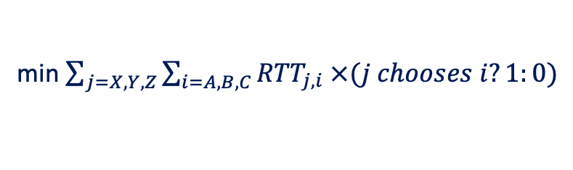
Solving the optimization problem
Anycast Site A
Anycast Site B
Anycast Site C
Pairwise comparison → all clients’ preference orders
Measure a client j’s RTT to a site i: RTT_{ji}
→ Simple facility location problem with clients’ preference orderings [RSUE1987]
X
Y
Z
Input to the
optimization
problem
RTT_{X,A} = 25 ms
RTT_{X,B} = 35 ms
RTT_{X,C} = 60 ms
A>B>C
RTT_{Y,A} = 30 ms
RTT_{Y,B} = 60 ms
RTT_{Y,C} = 25 ms
B>A>C
RTT_{Z,A} = 90 ms
RTT_{Z,B} = 100 ms
RTT_{Z,C} = 30 ms
C>A>B
min $\sum_{j=X,Y,Z}{\sum_{i=A,B,C}{{RTT}_{j,i} ×(j chooses i?1:0)}}$
Notes:
CL
From the pairwise comparison experiments, we can obtain all client’s preference order.
for example, in this figure, after the experiments, we can obtain the preference orders of clients X, Y, and Z
CL
Then, we can also measure the RTT of each client to each anycast site. As shown in this figure
CL
The preference orders and round trip time measurements are inputs to our optimization problem, which is minimizing the average client RTT based on client’s preferences
CL
It turned out, this problem is exactly the simple facility location problem with clients’ preference orderings, which is an NP hard problem and has no polynomial approximation solution.
Luckily, for the small scale that we handled now, we can search for he optimal configuration by explicit enumeration.

Slide 41
BGP Implementation tie breaks with arrival time
Cisco & Juniper Implementation
Local preference
AS_PATH
Origin of prefix
MED
Type of BGP session
Interior cost
Arrival time
Router id
Neighbor address
BGP specification [RFC 4271]
Local preference
AS_PATH
Origin of prefix
MED
Type of BGP session
Interior cost
Router id
Neighbor address
Announce a prefix from two sites in both orders
Notes:
Despite our proofs, we found that a client may not have a linear preference order under the scenarios stated in the previous slide.
after careful investigation, we found that typically this was caused by a BGP implementation issue
The left side list several factors in sequence described in the BGP RFC spec, Those factors are used in the tie breaking on the BGP router
Different from the RFC spec, the real implementation of the major network device manufactures usually have one more factor between interior cost and router id, and that is the route’s arrival time
CL
In order to account for the arrival order, in each pairwise comparison, we announce the prefix from the two sites in two different orders

Slide 42
Total Order Preserving
Nearly 90% of clients
even for 15 sites
Only 15%
w/o arrival order
Notes:
After resolving the arrival order, the ratio of clients that have a linear order increased significantly.
As shown in this graph, the x axis shows the number of anycast sites that we include in the pairwise comparison,
And the y axis shows the fraction of client that exhibits a consistent linear order with the pairwise comparison results.
When we resolved the arrival order, the fraction is nearly 90% even for 15 sites
But if we only announce to both sites simultaneously, the fraction is just 15%
# redraw
pa

Slide 43
Performance Comparison
-32 ms
-14 ms
Notes:
Because AnyOpt can estimate the RTT for different anycast configurations with just small error, we can search for the optimal configuration offline.
This graphs shows the RTT of different anycast configuraitons.
AnyOpt is the optimal configuration found in the offline optimization, it only includes 12 sites.
CL
As a comparison, we also select the top 12 sites with the smallest unicast average RTT, which is denoted with “12-greedy”.
CL
AnyOpt can achieve 32 ms median round trip time reduction with the same number of sites.
CL
We also compared it with the 15-all configuration, which means we announce the anycast prefix from all 15 available sites.
CL
Compared with the “15-all”, AnyOpt can still achieve 14 ms median round trip time reduction even with 3 lesser sites

Slide 44
Incorporating Peering Links
Adding peering links can reduce the median RTT by 7ms compared to the AnyOpt conf in our setting
Notes:
Adding multiple peering link can reduce the round trip time, in this graph, we shown the CDF of RTT of two more other configuration,
AnyOpt+BenefitPeers means we only include the peering links can explicitly improved the RTT in the standalone measurement.
AnyOpt+AllPeers means we include all available peering links in the configuration.
As shown in this graph, the first configuration can only reduce the median RTT by 4ms, but if we include all peering links, it can reduce the median RTT by 7ms.
This indicate that, while facing with more available peering links, the client usually can select a better one.

Slide 45
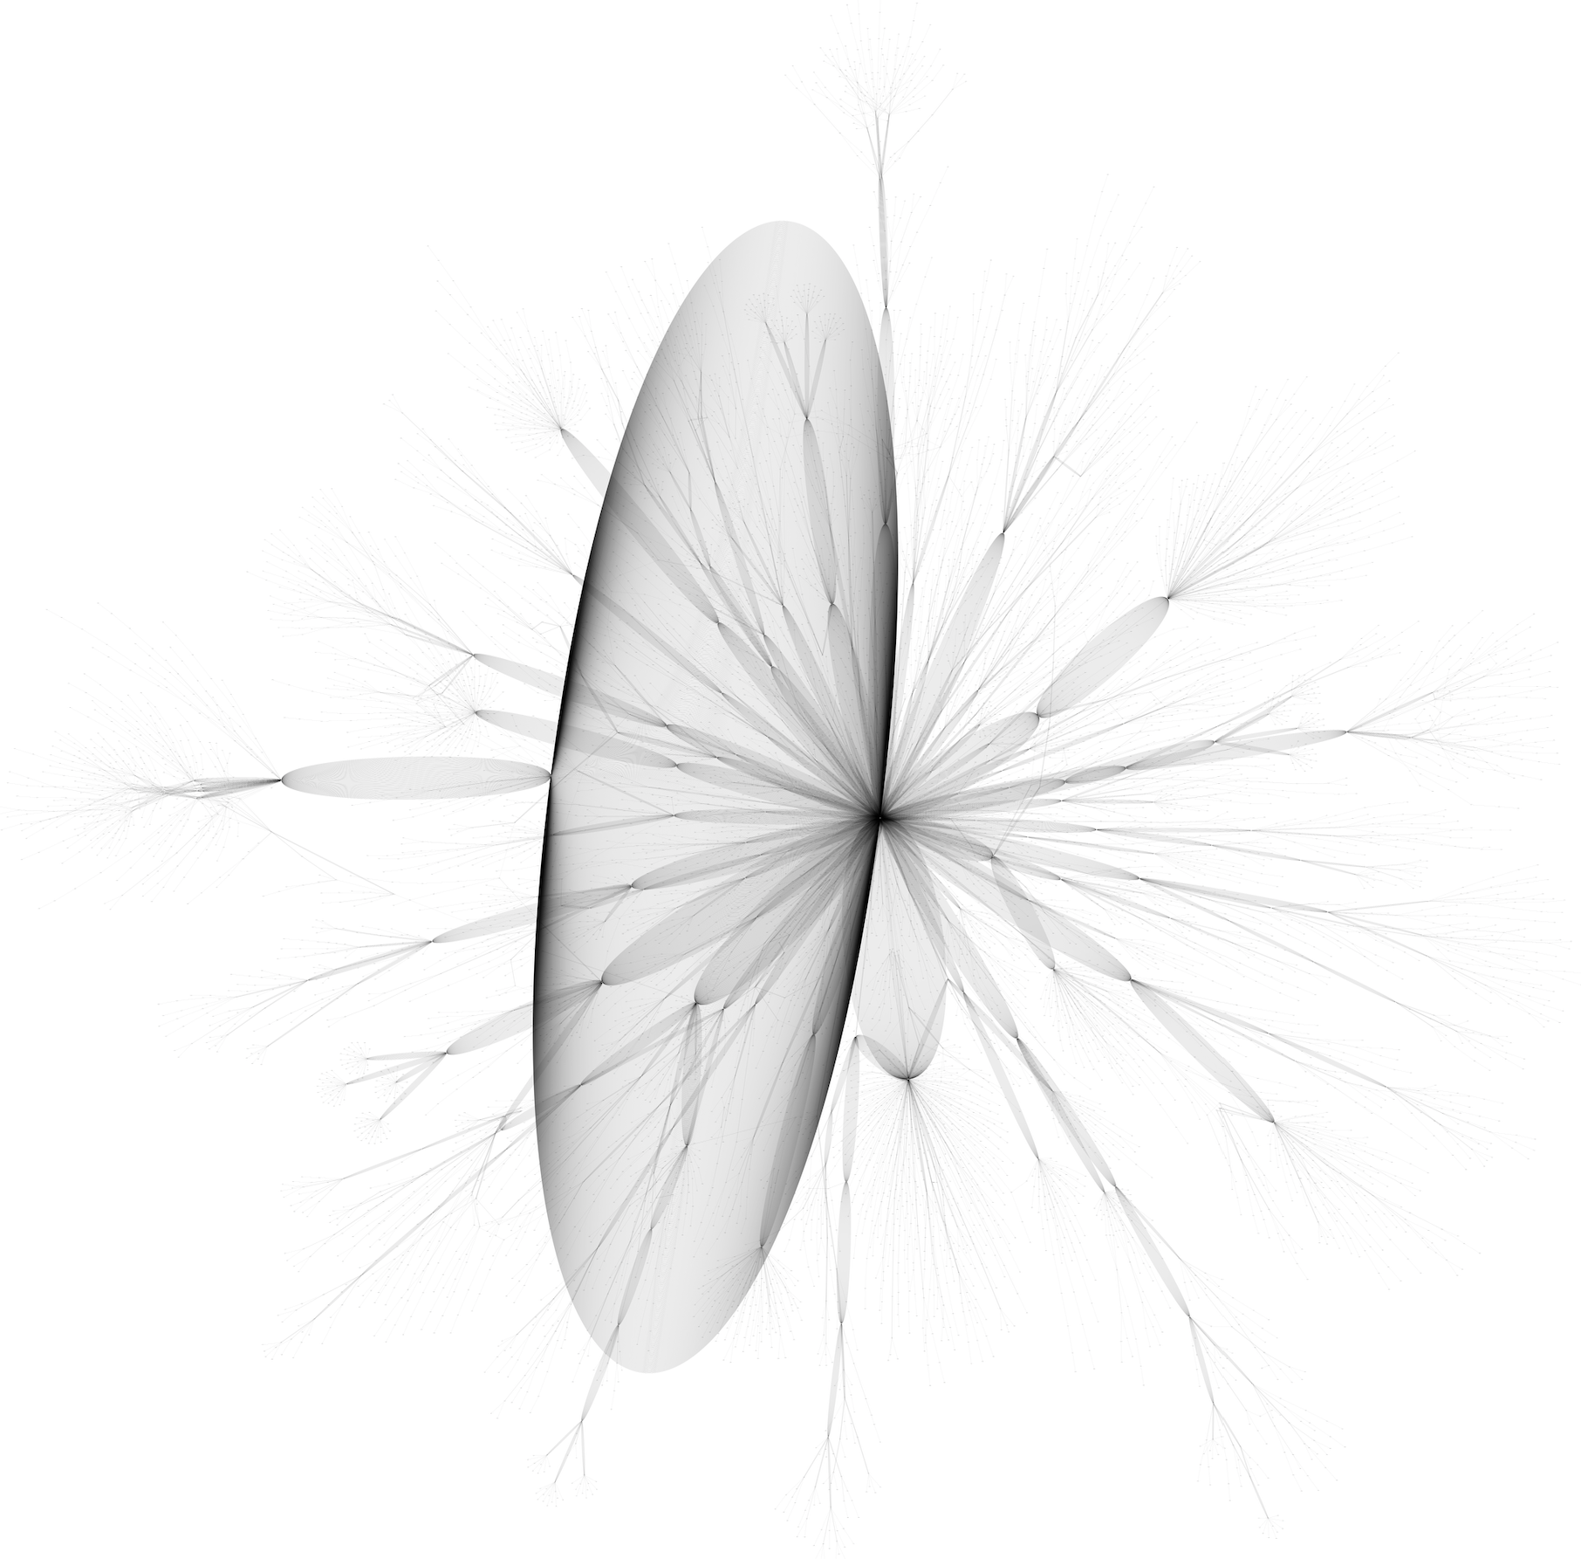
Network Trace
Trace Graph G(V,E) describes the Backward Trace (from client’s perspective)
Each V stands for the routers along the route
And E stand for the hop along the trace
The large ring stands for the parallel edges shared by multiple routes

Slide 46
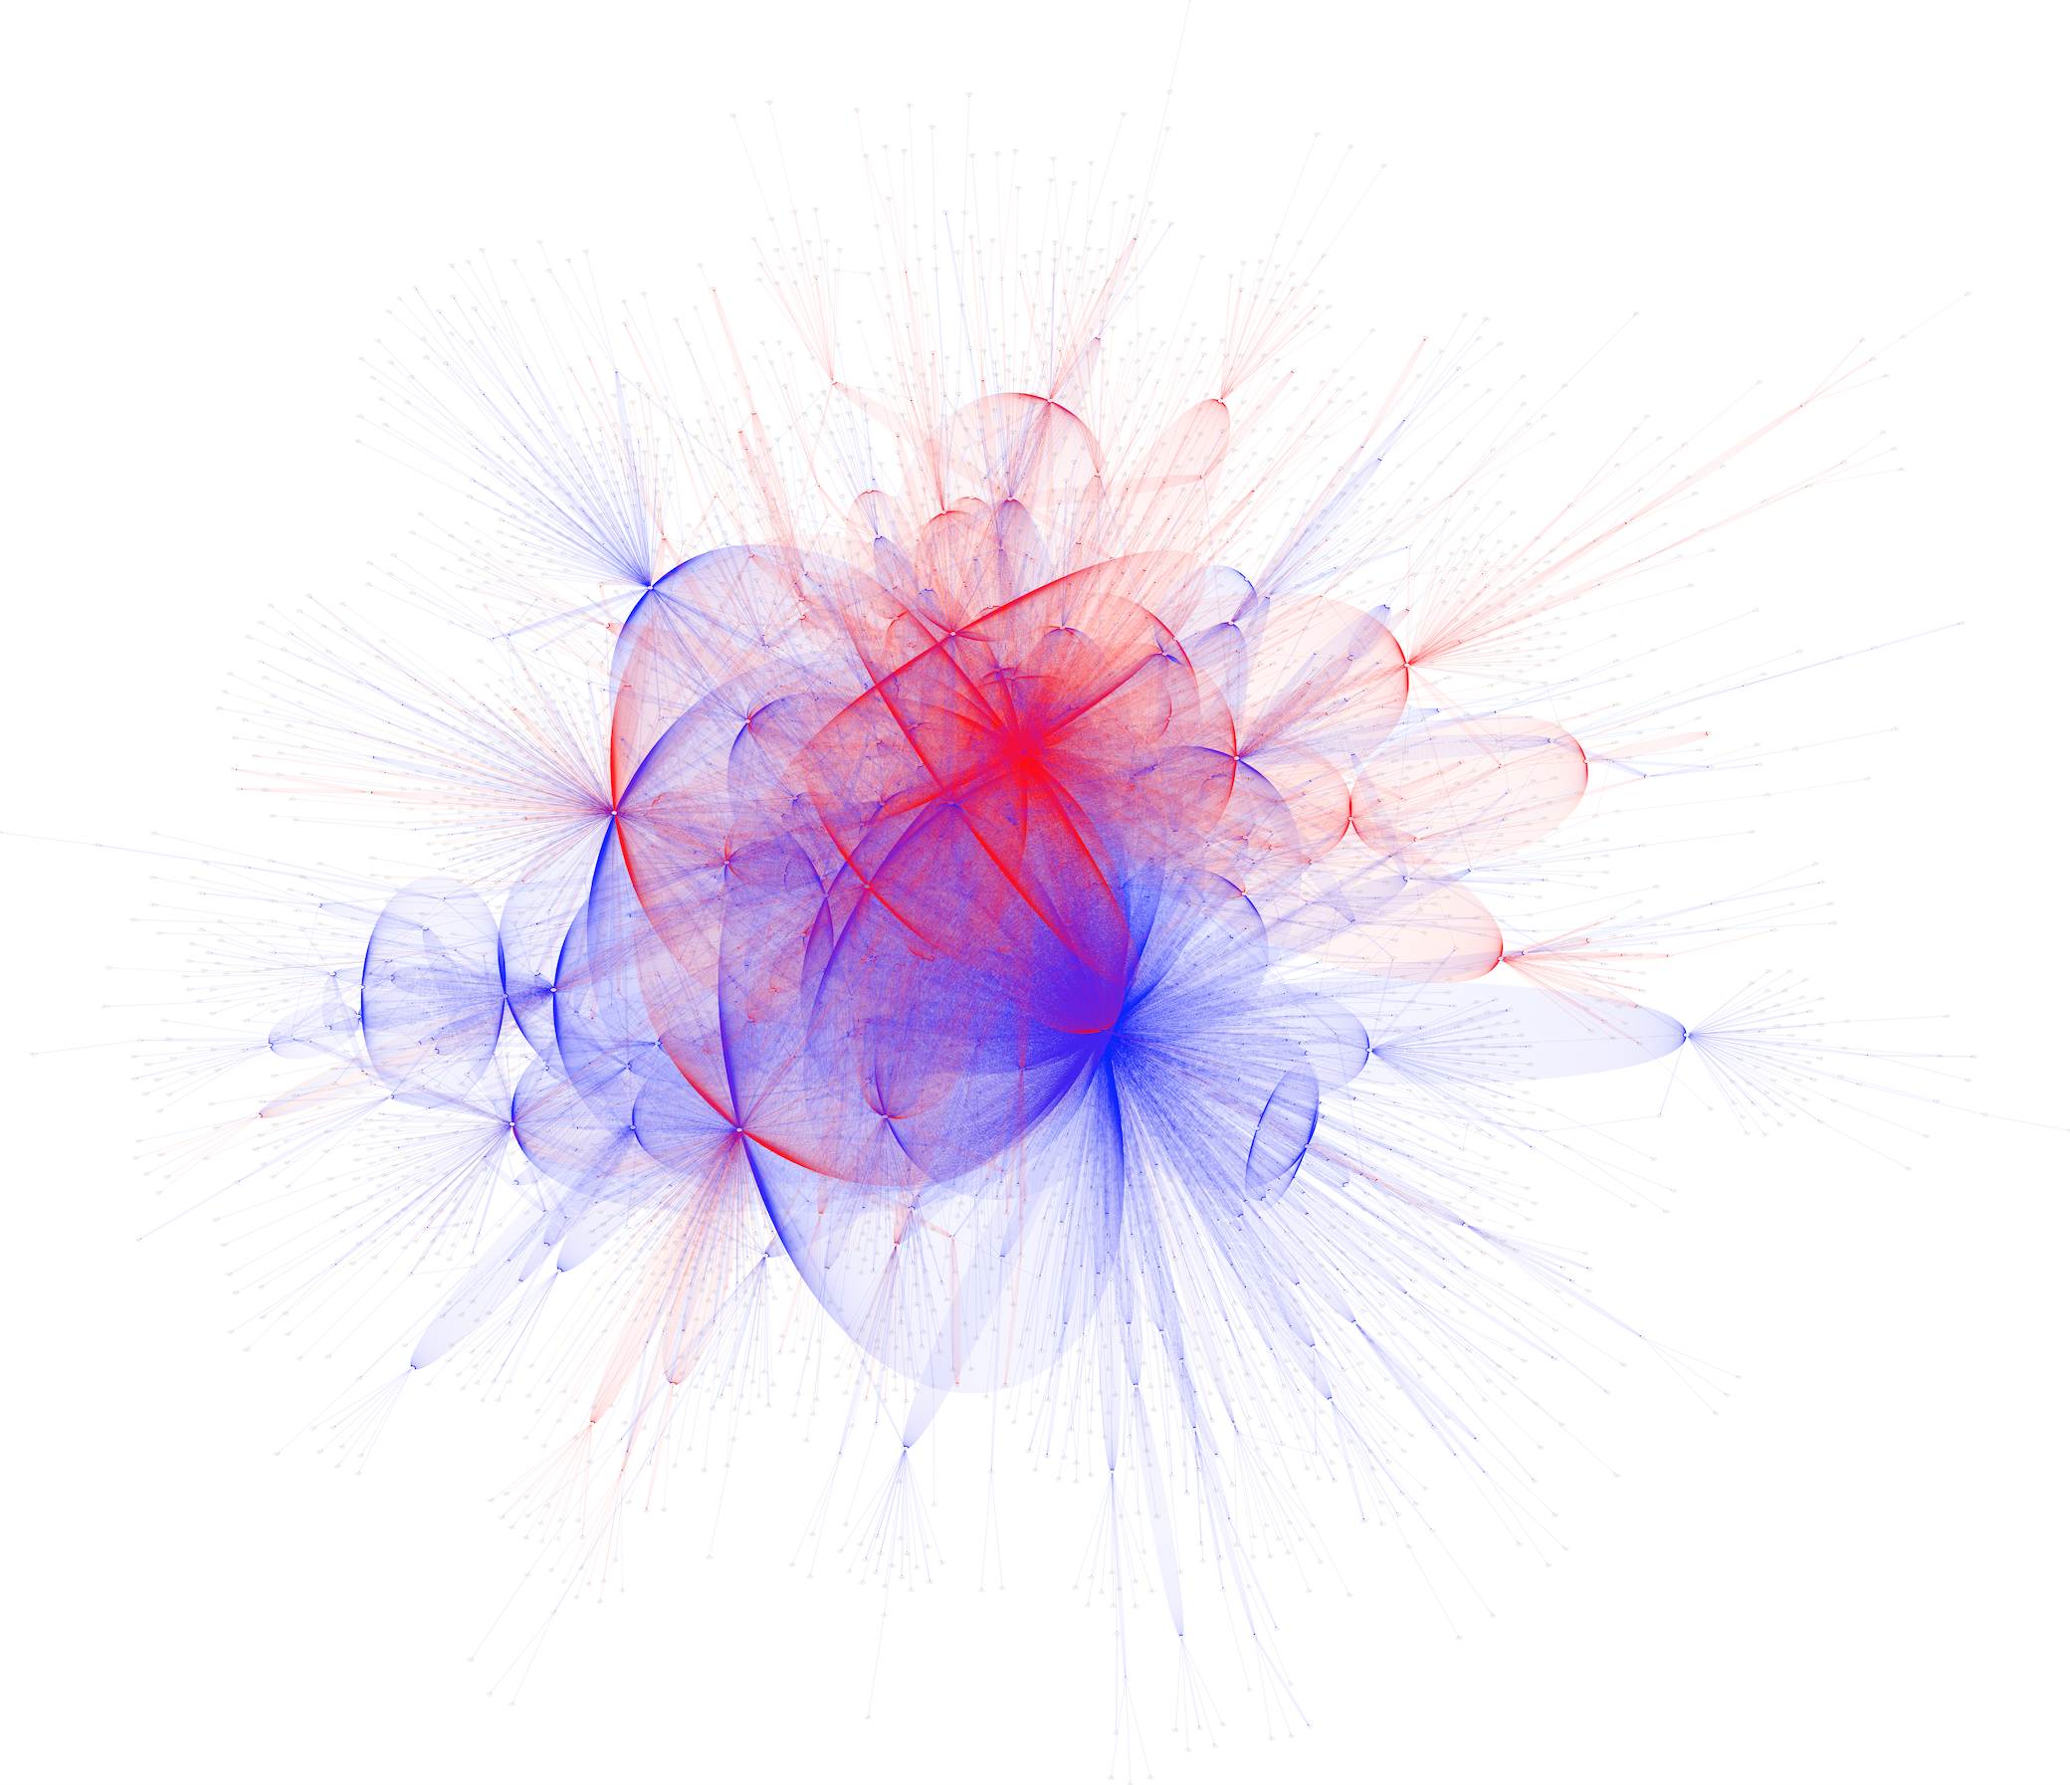
Traces from two Replicas
Trace Graph G(V,E) describes the Backward Trace (from client’s perspective)
Each V stands for the routers along the route
And E stand for the hop along the trace
Different color stands for different catchment
Notes:
Send out traceroute packets from two anycast sites
Two transit providers

